Slide 1
Topic 2: Interaction Design Process and Practice
SECV2113 Human-Computer Interaction
Faculty of Computing
Universiti Teknologi Malaysia

Slide 2
WHAT IS INVOLVED IN INTERACTION DESIGN
01
SOME PRACTICAL ISSUES
02
AGILEUX
03
DESIGN PATTERNS
04
OPEN SOURCE RESOURCES & TOOLS FOR INTERACTION DESIGN
05

Slide 3
WHAT IS INVOLVED IN
INTERACTION DESIGN

Slide 4
What is Involved in ID?
It is a process:
Focused on discovering requirements, designing to fulfil requirements, producing prototypes and evaluating them
Focused on users and their goals
Involves trade-offs to balance conflicting requirements
Generating alternatives and choosing between them is key
Four approaches: user-centered design, activity-centered design, systems design, and genius design

Slide 5
The Double Diamond of Design
Discover → Define → Develop → Deliver
Source: Adapted from www.designcouncil.org.uk/news-opinion/what-framework-innovation-design-councils-evolved-double-diamond
Notes:
• Double Diamond Model (Design Council, UK):
o Discover → Define → Develop → Deliver
o Demonstrate an iterative flow from understanding the problem to the end result.
(Menunjukkan aliran proses daripada memahami masalah hingga hasil akhir)

Slide 6
The Double Diamond of Design
Discover → Define → Develop → Deliver
Example : When designing a mobile banking app
Notes:
• Double Diamond Model (Design Council, UK):
o Discover → Define → Develop → Deliver
o Demonstrate an iterative flow from understanding the problem to the end result.
(Menunjukkan aliran proses daripada memahami masalah hingga hasil akhir)

Slide 7
Who to Involve in ID?
Identify stakeholders for the product
Individuals or groups who influence or are influenced by the success or failure of the project
Users are not the only stakeholders
Direct and indirect users, developers, executives, legislators
Involving stakeholders is not always easy
May not need to involve all groups
Knowing the stakeholder groups is only the first step!
Notes:
Siapa yang terlibat dalam ID?
Stakeholders:
semua individu atau kumpulan yang mempengaruhi atau dipengaruhi oleh kejayaan/kegagalan projek.
Pengguna langsung & tidak langsung, developer, pengurusan, undang-undang.
Tidak semua perlu dilibatkan, tetapi kenalpasti semua kumpulan utama.

Slide 8
Degrees of User Involvement
Member of the design team
Small group or individual activities
Online contributions from thousands of users
Online Feedback Exchange (OFE) systems
Crowdsourcing design ideas
Citizen engagement
Participatory design
User involvement after product release
A/B testing
Customer reviews

Slide 9
What is People-centered Approach?
Three principles for “useful & easy-to-use” products
Early focus on users and tasks
Empirical measurement
Iterative design
Expanded to include
People’s tasks and goals drive development
People’s behaviour and context is studied
People’s characteristics are designed for
Stakeholders are consulted throughout
Design decisions are taken in this context
Specific usability and user experience goals
Iteration through all interaction design activities

Slide 10
Four Basic Activities of ID
Discovering requirements
Designing alternatives
Prototyping alternative designs
Evaluating product and its user experience throughout

Slide 11
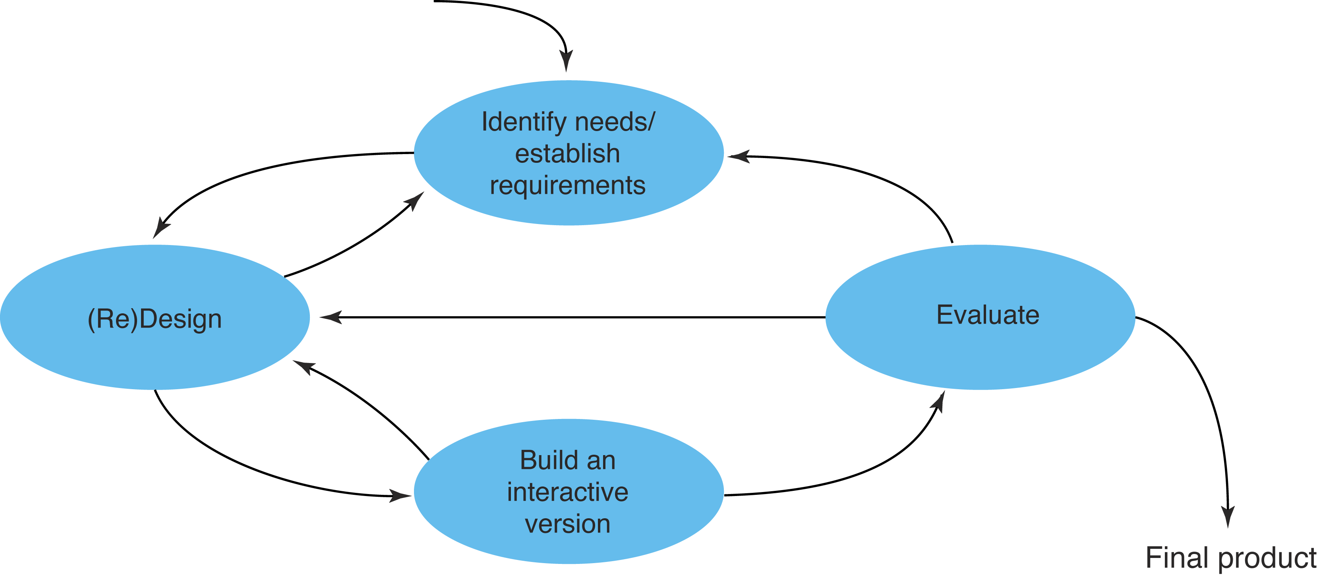
A Simple ID Lifecycle Model
Exemplifies a people-centered design approach
Identify the people who will use the product, what they will use it for, and under what conditions they will use it.
ideally through usability testing with actual users is important as quality testing is to good software development.
Identify conceptual model, task analysis, user analysis that must be met for the product to be successful.
This part of the process may be done in stages, building from a rough concept (prototype) to a complete design
Notes:
Lifecycle Models
• Simple ID Model: describes a people-centered approach.
• Design Sprints (Google) → fast iterations to validate ideas.
• Research in the Wild (Rogers & Marshall) → study use in a real context.

Slide 12
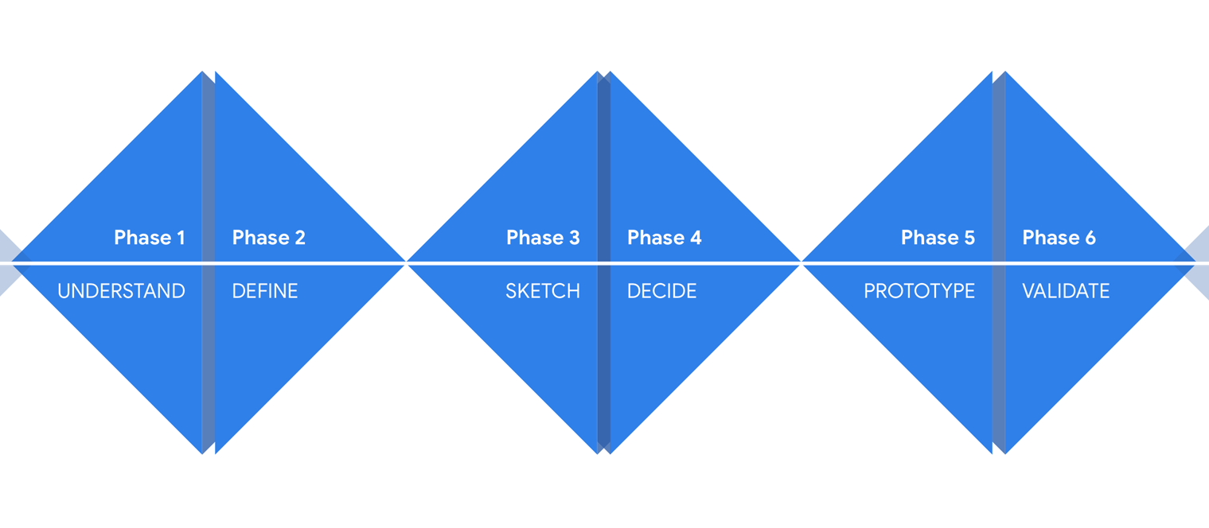
Another Lifecycle Model:
Design Sprints
Source: designsprintkit.withgoogle.com/methodology/overview
Notes:
Lifecycle Models
• Design Sprints (Google) → fast iterations to validate ideas.

Slide 13
Another Lifecycle Model:
Research in the Wild
A framework for research in the wild studies
Source: Rogers and Marshall, 2017, p6. (used courtesy of Morgan and Claypool)
Notes:
Lifecycle Models
• Research in the Wild (Rogers & Marshall) → study use in a real context.

Slide 14

Activity
Assume you are involved in developing a novel online experience for buying garden plants.
Although many websites exist for buying plants online, you want to produce a distinct experience to increase the organisation’s market share. Suggest ways of applying these five principles (see slide #8, no 1-5) in this task

Slide 15
SOME PRACTICAL
ISSUES

Slide 16
Some Practical Issues
How to find out what people need
How to decide what to design
How to generate alternative designs
How to choose among alternatives
How to integrate interaction design activities with other lifecycle models

Slide 17
How to find out what people need
Users rarely know what is possible
Instead:
Explore the problem space
Investigate potential users and their activities
Try out ideas with potential users
Focus on peoples’ goals, usability, and user experience goals, rather than expect stakeholders to articulate requirements

Slide 18
How to decide what to design
Explore
What is the current user experience?
Why is a change needed?
How will this change improve the situation?
Articulating the problem space
Team effort
Explore different perspectives
Avoid incorrect assumptions and unsupported claims

Slide 19
How to generate alternative designs
Humans tend to stick with something that works
Considering alternatives helps identify better designs
Where do alternative designs come from?
‘Flair and creativity’: research and synthesis
Cross-fertilisation of ideas from different perspectives
Users can generate different designs
Prompts to provoke thinking, e.g. SCAMPER
Seek inspiration: other products and domain
Different perspectives
Balancing constraints and trade-offs

Slide 20
How to choose among alternatives
Interaction design focuses on externally-visible and measurable behavior
Technical feasibility
Evaluation with users or peers
Prototypes not static documentation because behavior is key
A/B Testing
Online method to inform choice between alternatives
Nontrivial to set appropriate metrics and choose user group sets
Quality thresholds
Different stakeholder groups have different quality thresholds
Usability and user experience goals lead to relevant criteria

Slide 21
How to integrate ID activities within other models
Integrating interaction design activities in lifecycle models from other disciplines requires careful planning
Software development lifecycle models are prominent
Integrating with agile software development:
It incorporates tight iterations
It champions early and regular feedback
It handles emergent requirements
It aims to strike a balance between flexibility and structure

Slide 22
AGILEUX

Slide 23
Technical Debt in UX
Making compromises that are expedient in short term, but cause problems in long term
Refactoring to correct pragmatic trade-offs
UX debt arises from trade-offs
A history of neglecting UX
Large portfolio of products developed independently

Slide 24
Agile Development
Short (one to three week) timeboxes of iterative development (sprint, iteration, cycle)
Early and repeated customer/user feedback
Re-prioritization of work based on customer or user feedback so that emergent requirements can be handled
Many approaches, for example, eXtreme Programming (XP), Scrum, Kanban, and DSDM
Notes:
Agile Development Basics
Short sprints (1–3 weeks).
Frequent feedback.
Re-prioritization based on results.
Methods: Scrum, Kanban, XP, DSDM.
Agile Development
Sprint pendek (1–3 minggu).
Customer feedback berulang.
Re-prioritization ikut maklum balas.
Contoh: XP, Scrum, Kanban, DSDM.

Slide 25
AgileUX
Integrates techniques from interaction design and agile methods
AgileUX requires balancing research and reflection for good UX with rapid iterations incorporating user feedback
In Agile iterations, requirements are elaborated and re-prioritised, rather than specified up-front

Slide 26
AgileUX (cont.)
All techniques in UX are still relevant, but when to use and how much needs careful planning
Focus on product, not design, as deliverable
Cross-functional teams
Three practical areas: user research, aligning work practices, and documentation

Slide 27
User Research
Seeks to characterise users, tasks, and context through data gathering and analysis
Detailed user research cannot be fitted within a limited timebox
Some user research can be performed in iteration 0 (zero), before implementation starts
Ongoing program of user research over a longer period of time

Slide 28
LeanUX
Build evidence for design decisions by creating and deploying products quickly to get real user feedback
Tight iterations of build-measure-learn
Minimum viable product tests assumptions
Source: Gothelf, J. with J. Seiden (2016) Lean UX, 2nd edition, O’Reilly.

Slide 29
LeanUX Canvas
Seeks to characterise users, tasks, and context through data gathering and analysis
Detailed user research cannot be fitted within a limited timebox
Some user research can be performed in iteration 0 (zero), before implementation starts
Ongoing program of user research over a longer period of time

Slide 30
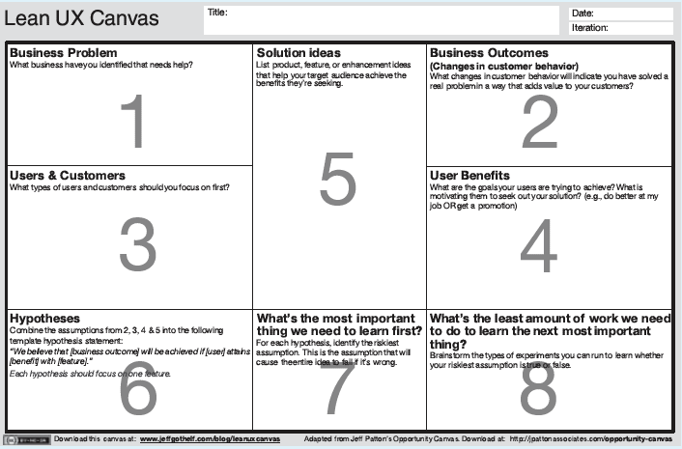
Source: Available for download from jeffgothelf.com/blogs/leanuxcanvas
Notes:
Business problem: What business have you identified that needs help?
Business outcomes (changes in customer behavior): What changes in customer behavior will indicate you have solved a real problem in a way that adds value to your customers?
Users and customers: What types of users & customers should you focus on first?
User benefits: What are the goals your users are trying to achieve? What is motivating them to seek out your solution?
Solution ideas: List product, feature, or enhancement ideas that help your target audience achieve the benefits they’re seeking.
Hypotheses: Combine the assumptions from 2, 3, 4 and 5 into a hypothesis statement: “We believe that [business outcome] will be achieved if [user] attains [benefit] with [feature].”
What’s the most important thing we need to learn first? For each hypothesis, identify the riskiest assumption. This is the assumption that will cause the entire idea to fail if it’s wrong.
What’s the least amount of work we need to do to learn the next most important thing?

Slide 31
Aligning Work Practices
Designing a complete product upfront causes problems because of re-prioritization
Some upfront work is needed (technical and UX)
Use a dual tracks approach:
Create product vision before development starts
Do design work one iteration ahead of development
Some teams work two iterations ahead

Slide 32
Dual Tracks Approach to AgileUX
Source: Sy, D. (2007) Adapting usability investigations for development, Journal of Usability Studies 2(3), May, 112–130.

Slide 33
Aligning Work Practices (cont.)
Advantages of dual tracks approach:
No design time wasted on features not implemented
Usability testing and contextual inquiry could be done on the same customer visit, saving time
Timely feedback on the designs was received from developers and customers
Agile flexibility supports schedule changes if a problem is found
Parallel tracks is commonly used

Slide 34
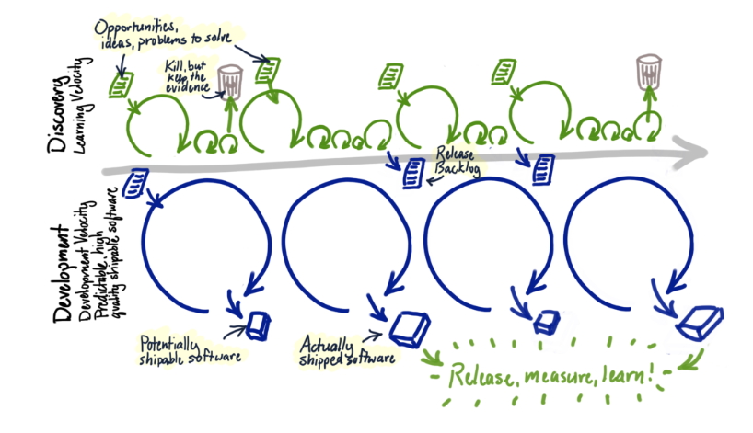
Dual Tracks: Discovery & Development
Source: www.jpattonassociates.com/dual-track-development

Slide 35
Documentation
Common communication approach for UX designers
Agile encourages minimal documentation so more time can be spent on design and discussion
Only use documentation where needed. Ask:
Can the amount of time spent on documentation be reduced?
Who uses documentation?
What is the minimum needed by readers?
How efficient is the sign-off process?
Is there duplication anywhere?
How polished does documentation need to be?

Slide 36
DESIGN
PATTERNS

Slide 37
Design Patterns
Capture design experience:
A solution to a problem in a context
Can be instantiated in many ways: generative
Patterns may be individual, in languages, in catalogues, galleries, or libraries
Patterns often are associated with software components, for example, GitHub or platform websites

Slide 38




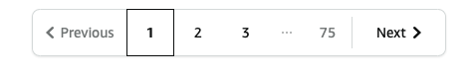

Design Patterns
Continuous scrolling
Pagination

Slide 39
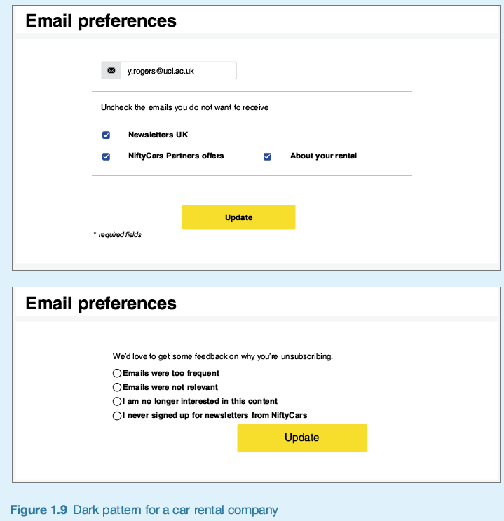
Bad Design Patterns
Capture design experience — but that doesn’t necessarily mean good design:
Anti-patterns: Don’t do it this way! (classing e.g.: “click here”)
Dark patterns: deliberate tricks

Slide 40
Design Language and Systems
Structured collection of patterns and components
May also include brand or accessibility guidelines
Reduce effort, support learning between designers and increase collaboration
Larger chunks of design can be reused
User flows, e.g. overflow.io or uxarchive.com)

Slide 41
OPEN SOURCE
RESOURCES & TOOLS FOR ID

Slide 42
Open-Source Resources
Components, frameworks, systems available free of charge
Community-driven
Available for interaction design:
Design pattern libraries
Bootstrap framework

Slide 43
Tools for Interaction Design
Tools support all aspects of the design process:
Creativity, sketching, simulation, brainstorming, library search, mind mapping, and video capture
Tools integrate together to speed up prototyping
Tooling landscape changes all the time
Interactive wireframes or mockups can be produced using, for example:
Sketch©
Balsamiq©
Axure©
Figma©
Higher-fidelity prototypes can be produced by linking interactive wireframes to design pattern library with software components

Slide 44
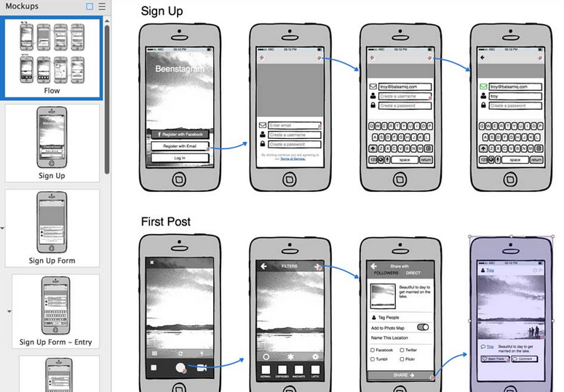
Balsamiq

Slide 45
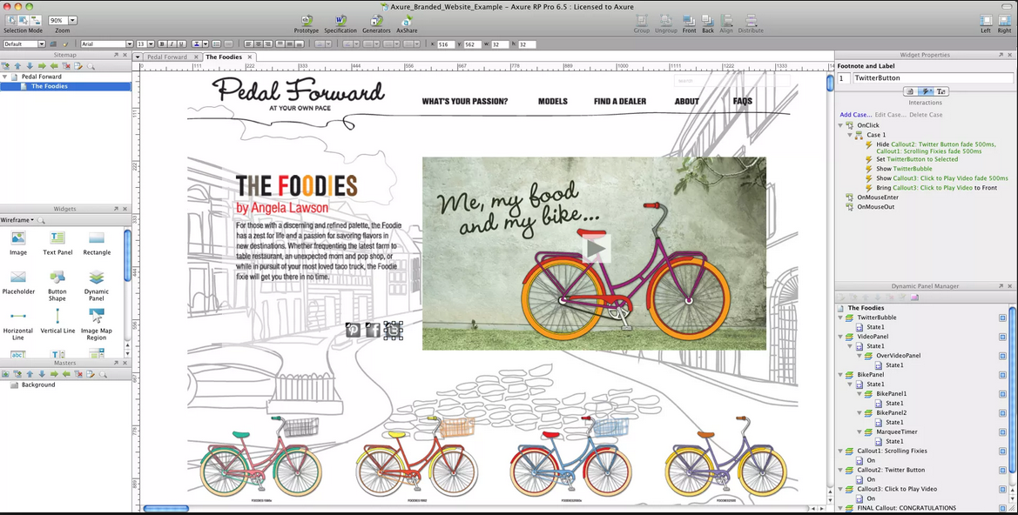
Axure

Slide 46
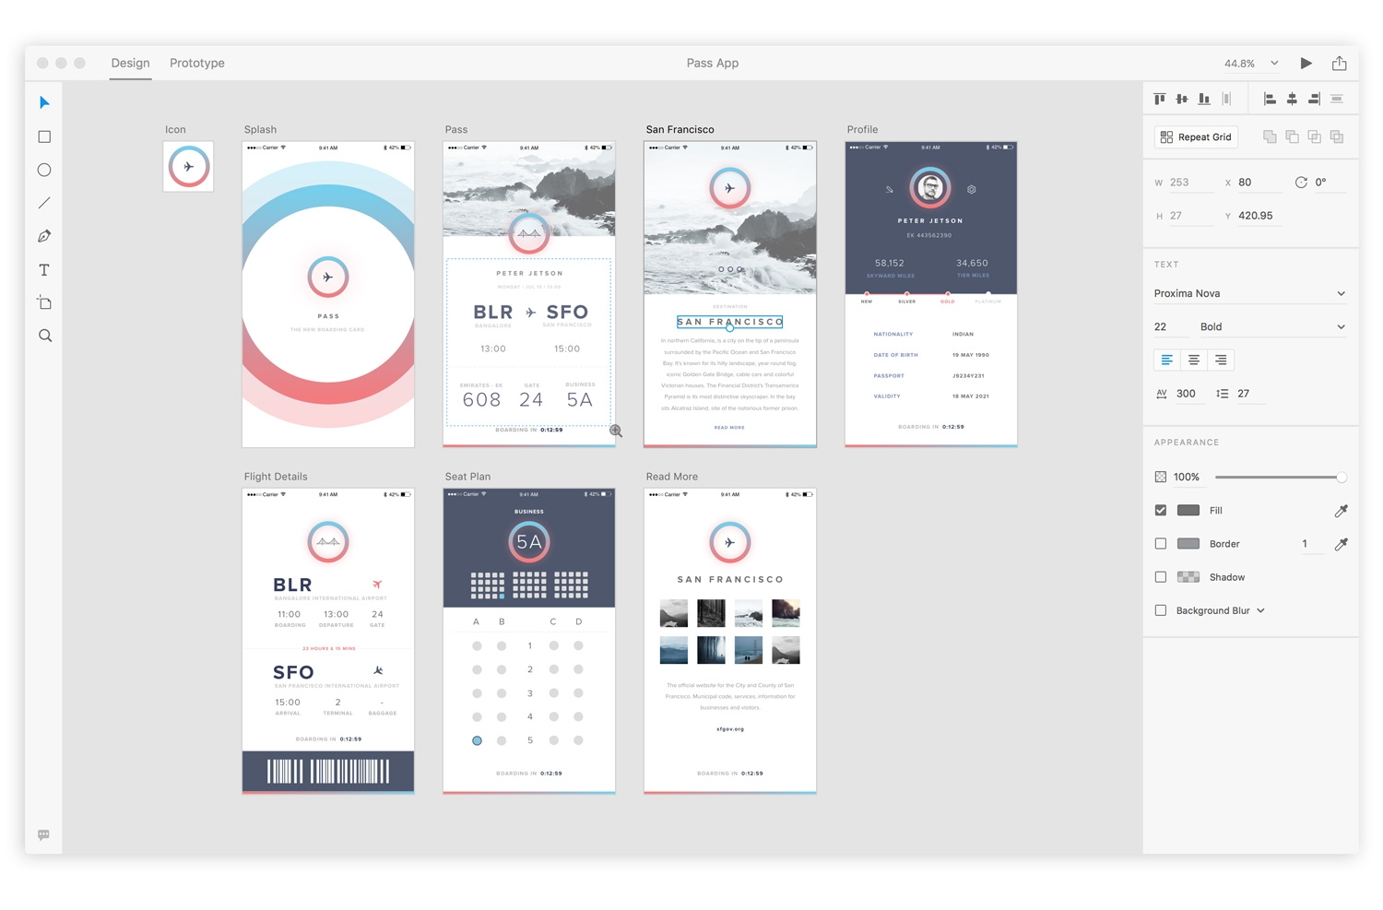
Adobe XD

Slide 47
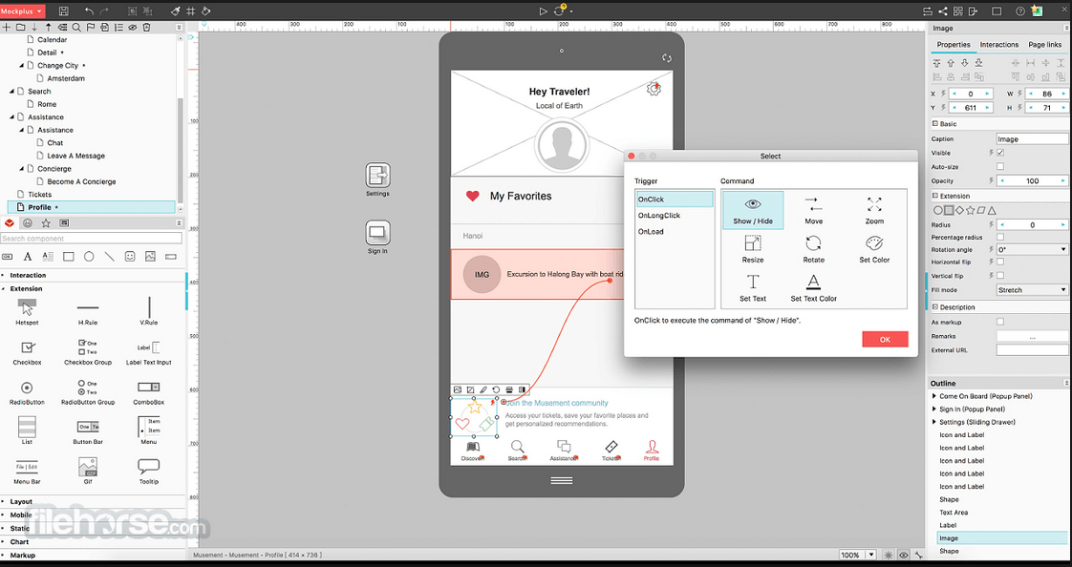
Mockplus

Slide 48
Summary (1)
Four basic activities in interaction design process
Discovering requirements
Designing alternatives
Prototyping
Evaluating
People-centered design rests on three principles
Early focus on users and tasks
Empirical measurement
Iterative design
Understand problem space before starting design
Involve stakeholder groups throughout development
Generate alternative designs and evaluate them

Slide 49
Summary (2)
AgileUX refers to approaches that integrate UX design and agile development
Needs a balance between research and reflection, and rapid iterations
Requirements are repeatedly re-prioritized, which seeks to avoid wasted effort
UX design activities need careful planning: when, how much, and how to take forward
Design patterns and implementation libraries support good user experience design (look out for anti- and dark patterns)
Open source resources, for example, on GitHub, make development of standard applications easier and quicker
A range of digital tools to support interaction design in practice is available

